Slide 1



GAM220: World Creation - Game Development Project 1
05
Handling Game Spaces

Slide 2
First a disclaimer
Some of this has already been touched on in Game Design 2 – so apologies for any repetition.
It’s impossible to be avoid overlap completely.

Slide 3
What is the game space?
World Context
Gamespaces and GameMechanics
Consistenancy

Slide 4
What is the game space?
World Context
Gamespaces and GameMechanics
Consistency

Slide 5
What is the game space?
The virtual space within which a video game takes place.
The environment in which the ‘gameplay’ occurs.
Key to this are its features:
Navigation and boundary – e.g. Single screen/scrolling/wraparound/etc
Context – The setting.
Influences/forces/mechanics e.g. Gravity.
How information is presented – e.g. graphic style/audio feedback/game conventions and vocabulary.

Slide 6
Game
Gamespace (& Boundary)
Context
Level Design
Game mechanics

Slide 7
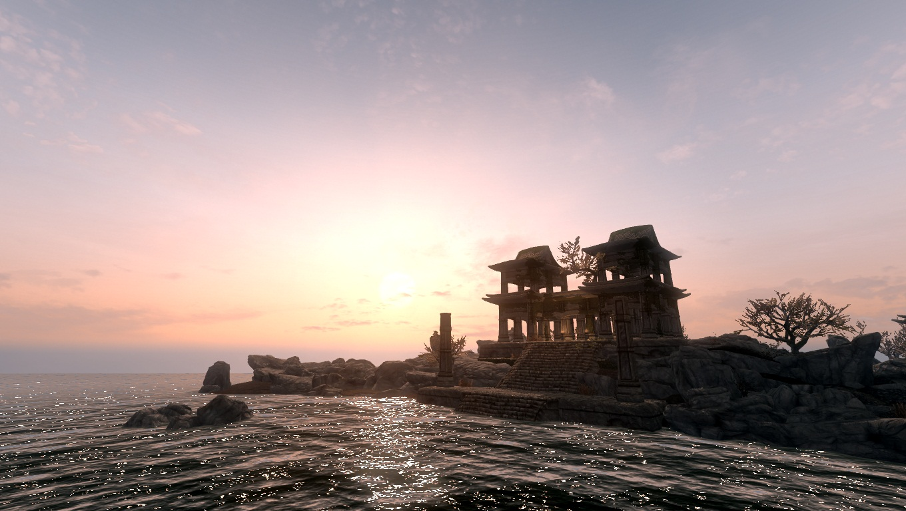

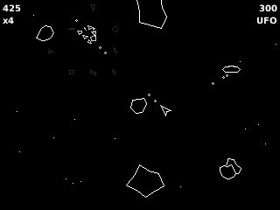
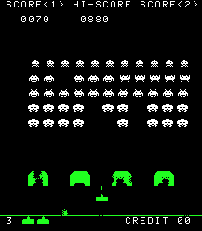

What bounds the playspace
Single Screen – bounded by the screen edges?
Wraparound
Scrolling (is it endless?)
Bounded by the world setting/context
Gamespace ‘endless’

Slide 8
How big is a gamespace?
What about gamespaces larger than so far discussed.
For anything bigger than single screens/limited scrolling games we need to have a way of breaking down gamespaces into smaller chunks.

Slide 9
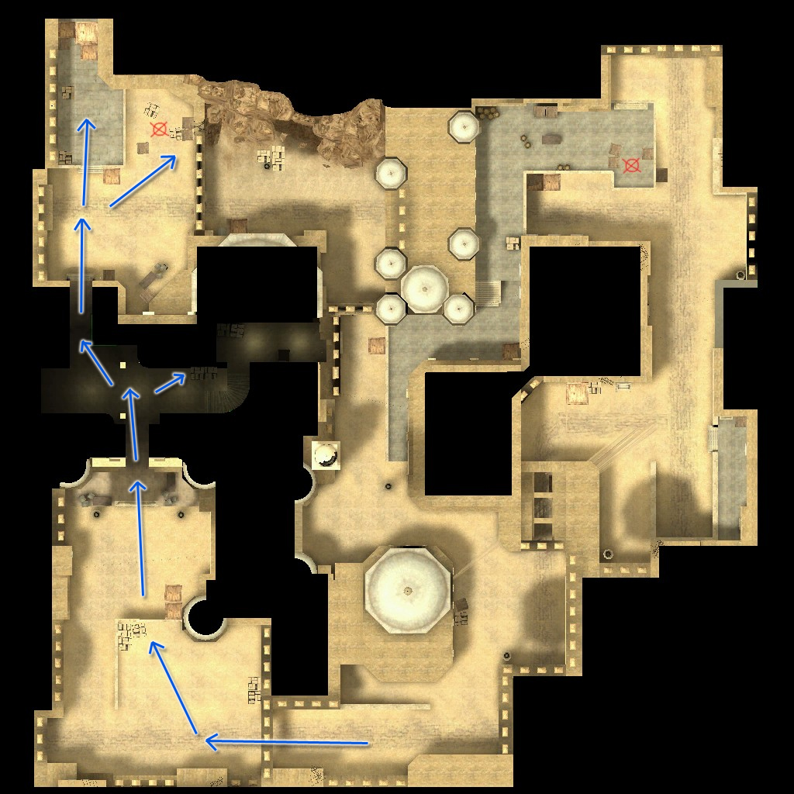
DUST CSGo map
~100 metres sq?

Slide 10
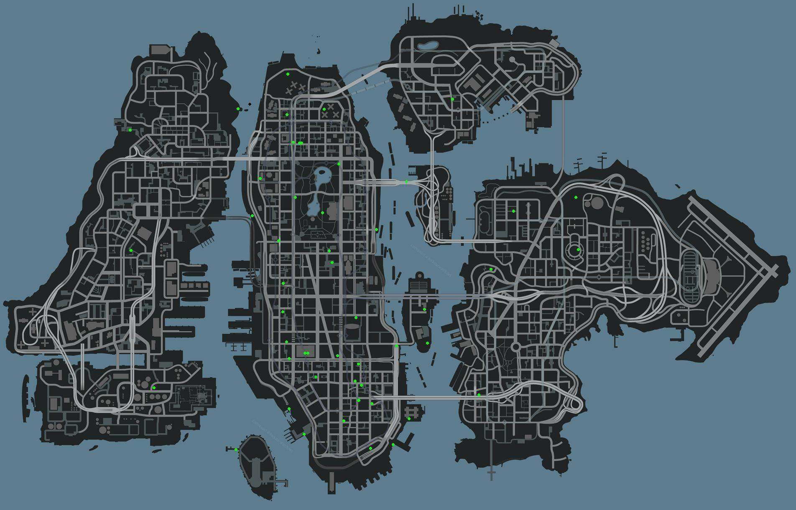
GTA4
~ 8.89km2

Slide 11
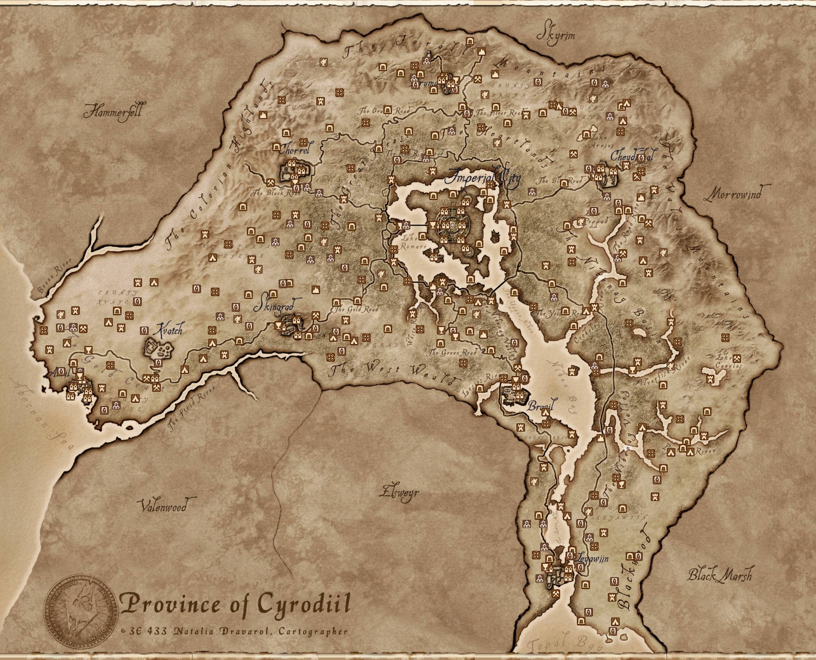
Oblivion
~ 22km2

Slide 12
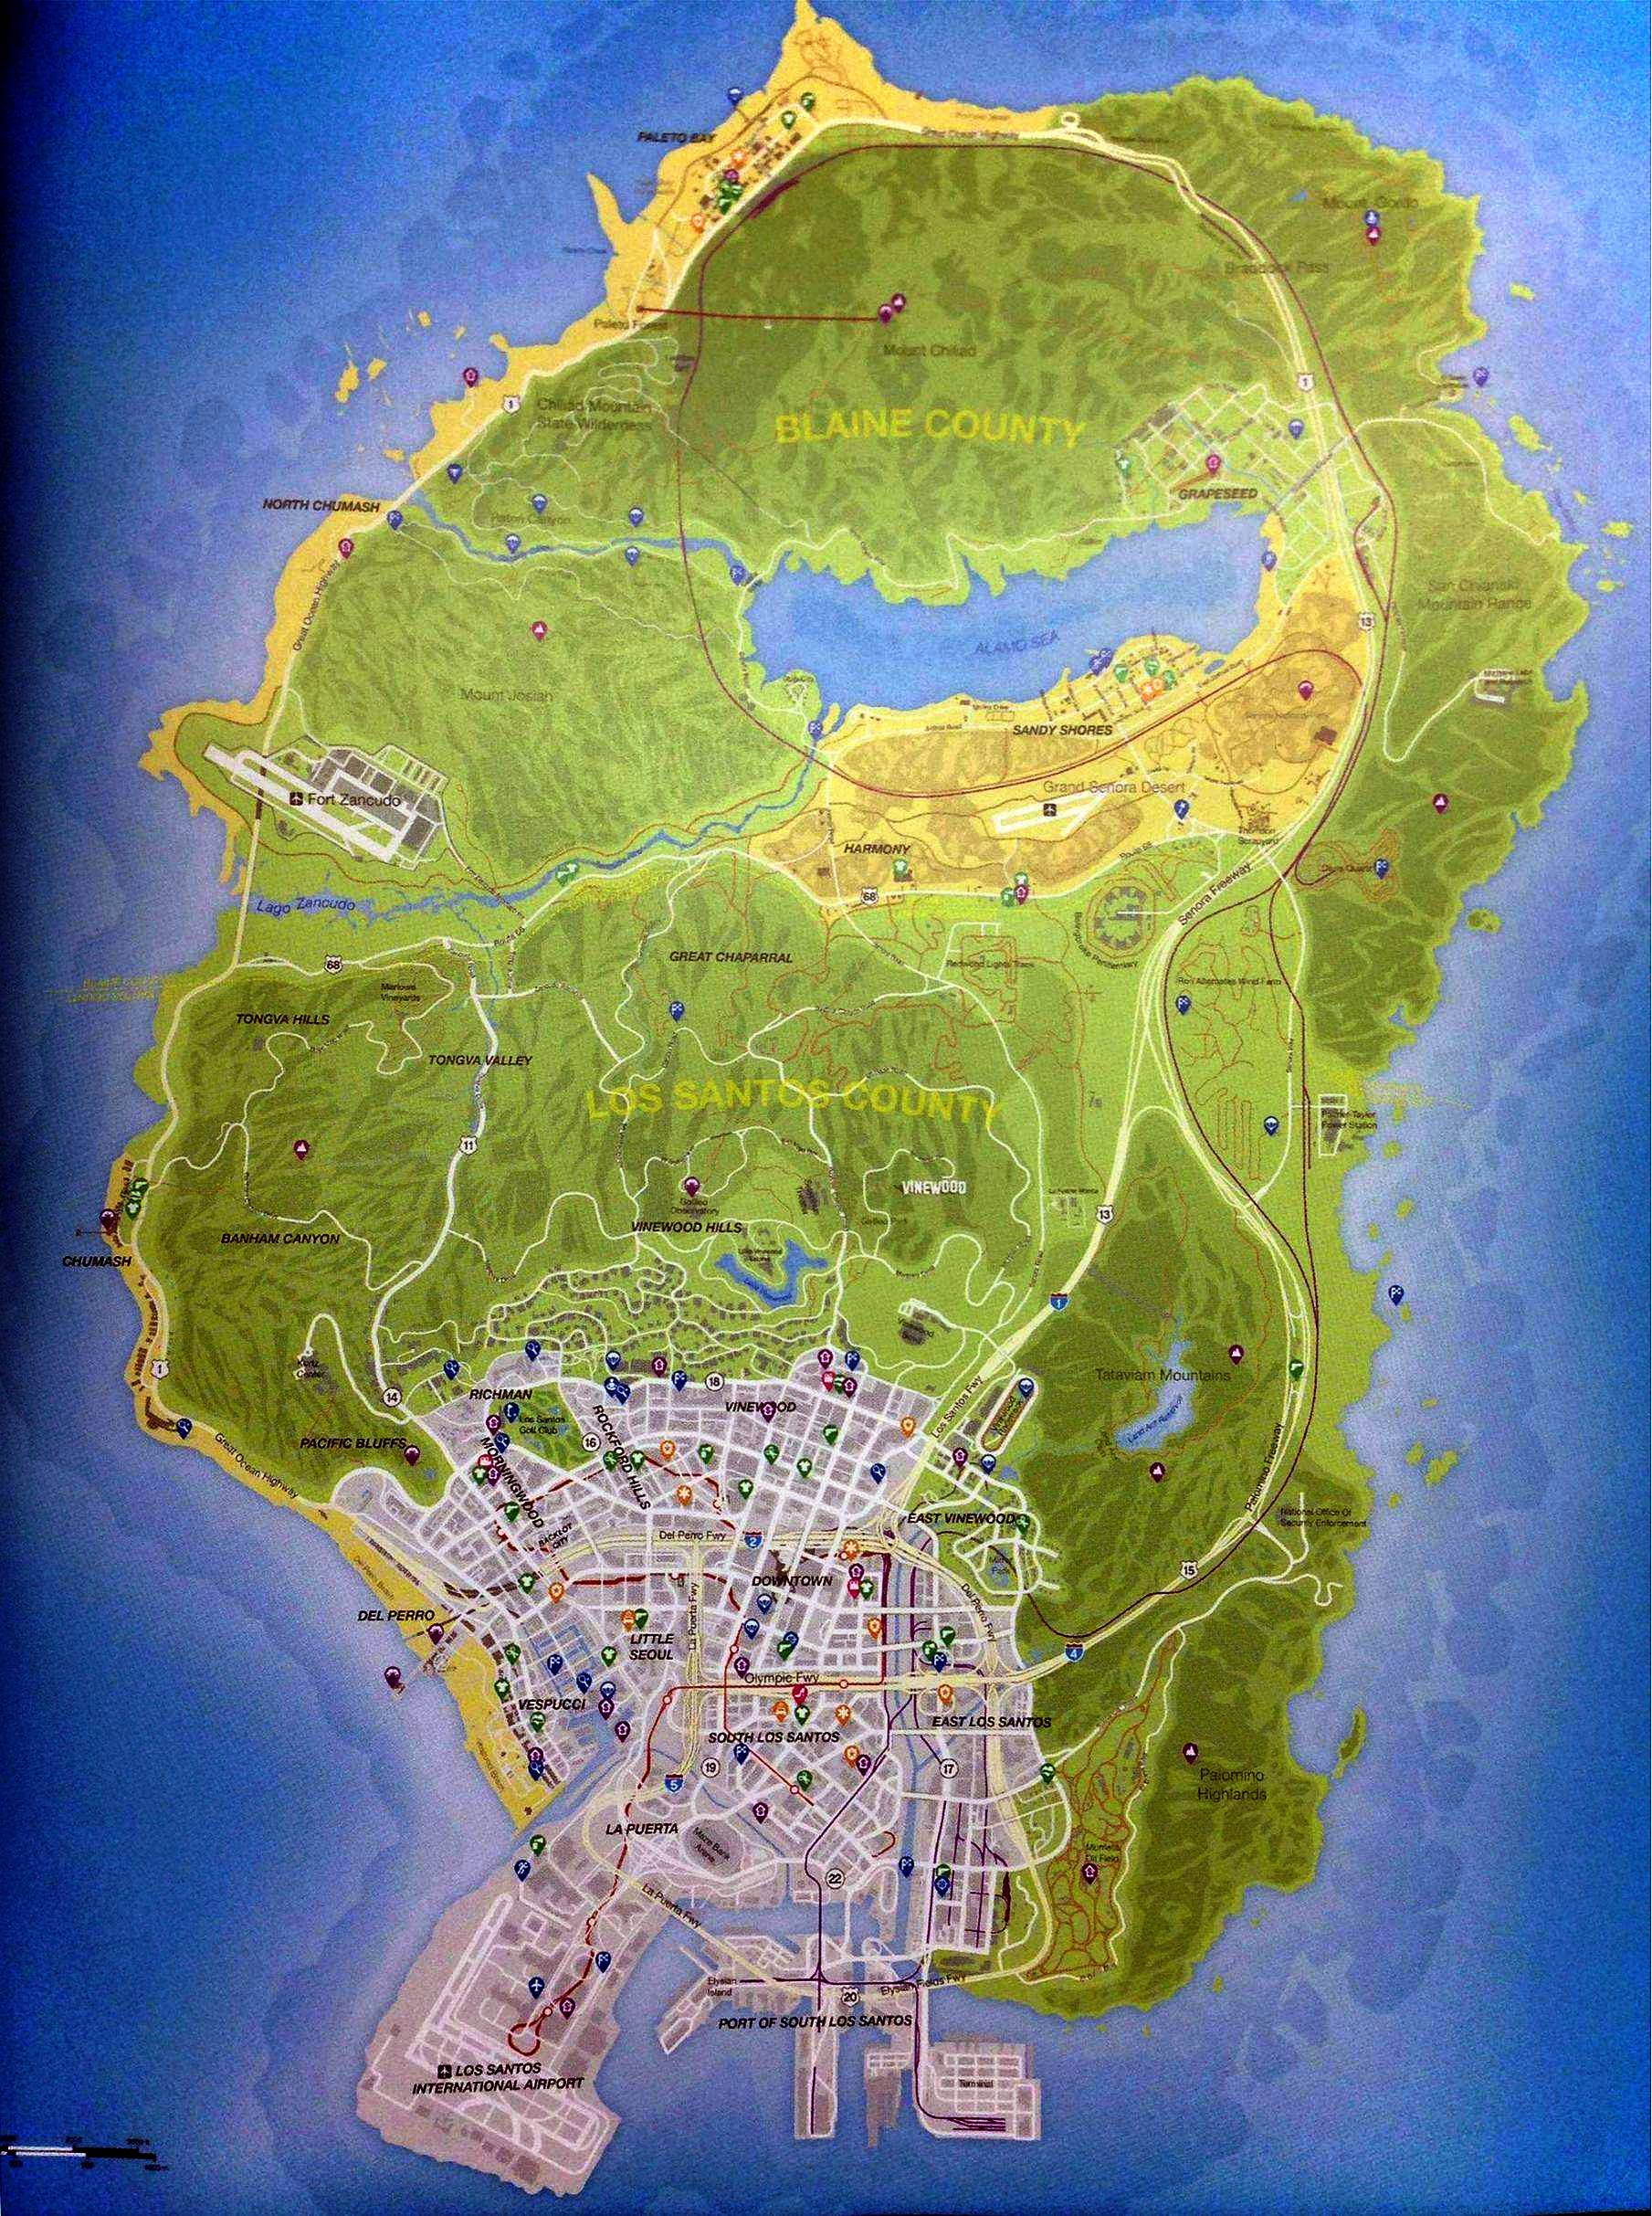
GTA 5
~ 45.52km2

Slide 13
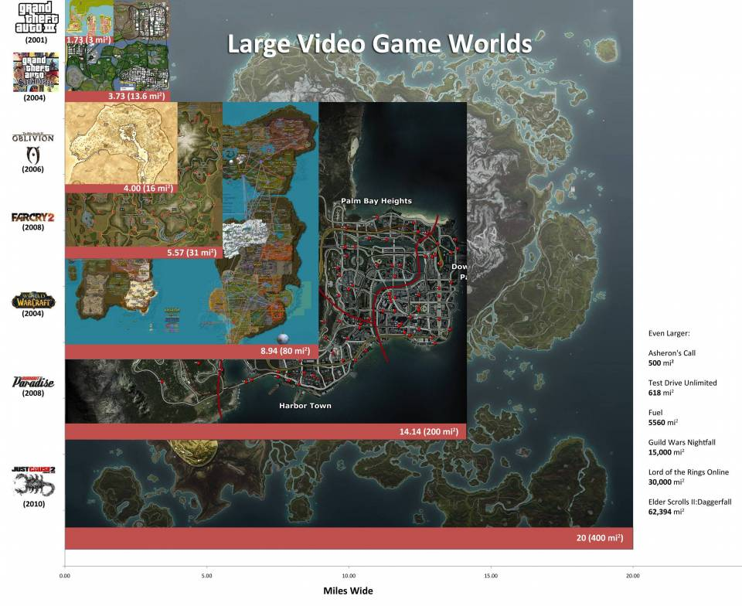

Slide 14
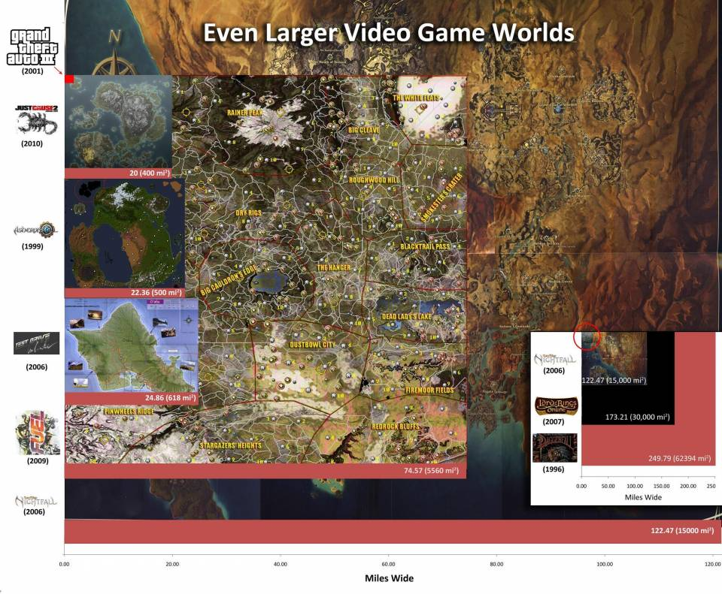

Slide 15
Organising Playspaces
How do you organise these playspaces? What terminology to you use?
These are often arranged in a hierarchy For example*:
World (universe?)
Setting/Plane/district
Space/Level
Zone /Area
Encounter
However, there is little consistency between developers – so you need to define this yourself on a project by project basis
*Tadhg Kelly (www.whatgamesare.com/world.html) suggests this hierarchy:

Slide 16
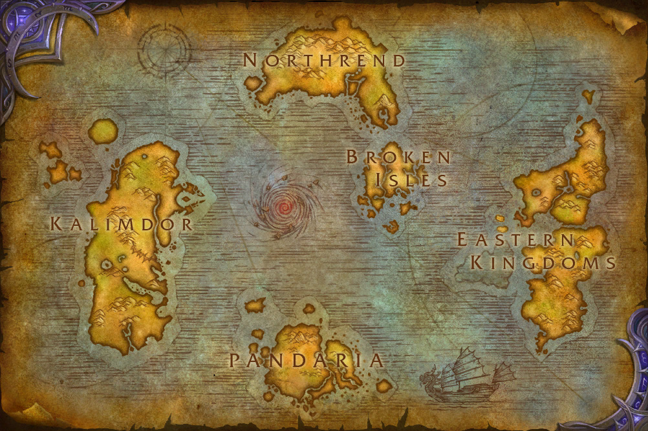
World

Slide 17
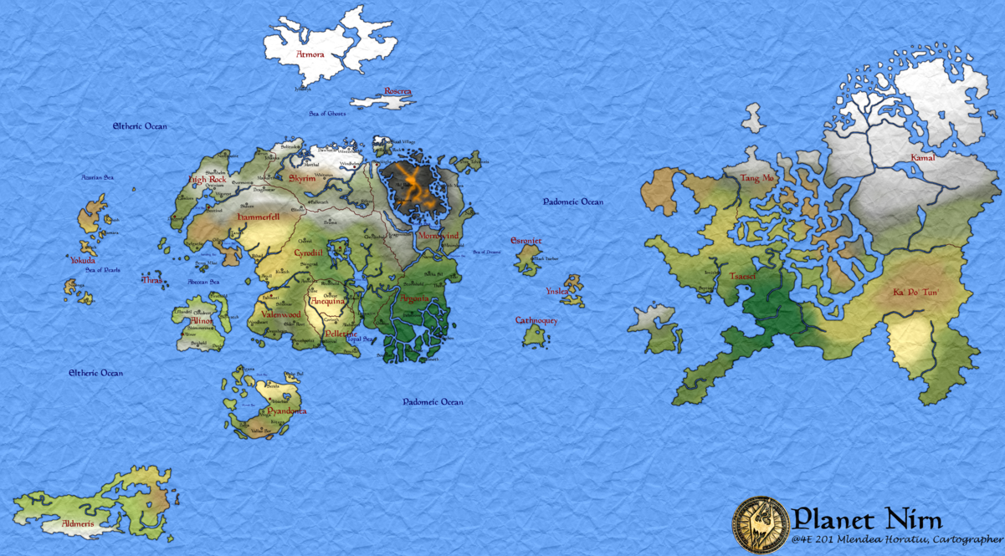
World

Slide 18
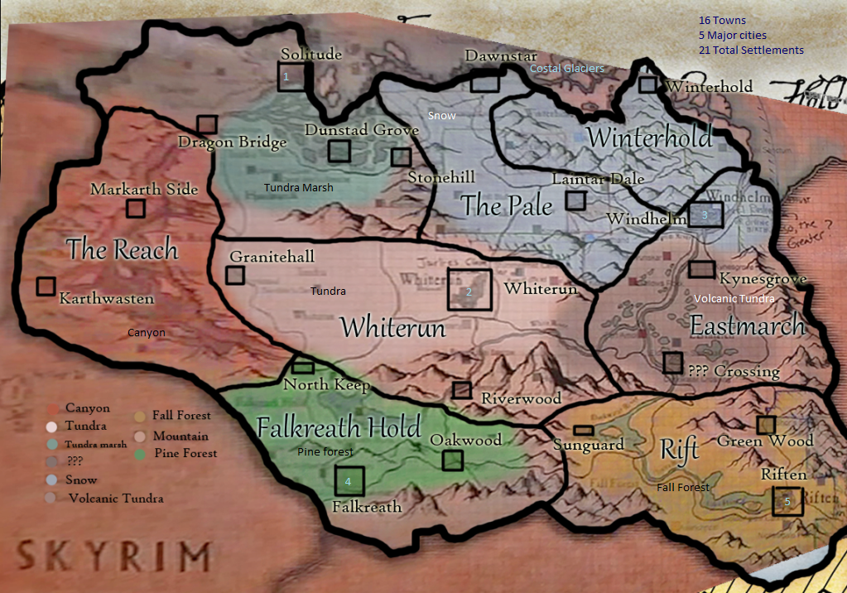
Setting

Slide 19
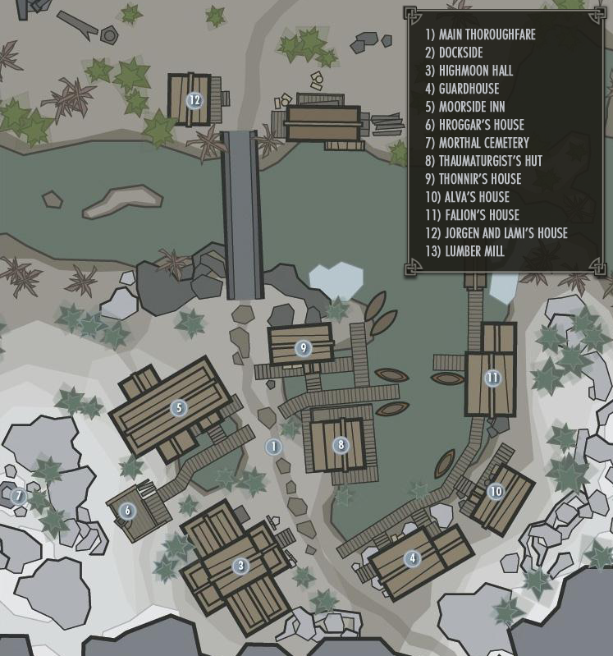
Level

Slide 20
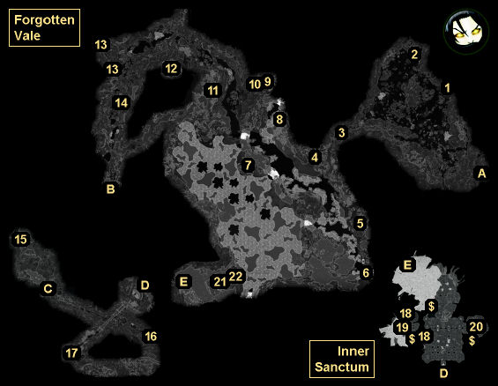
Zone/Area
Encounter

Slide 21
Levels
We naturally think in terms of levels – why ?
Bound the space…
Manage memory and other finite resources
Manage storytelling (allow themes)
Pacing (and progression)
Manage the learning curve and difficulty levels
Rewards
Lots of reasons

Slide 22
Level Design
The art of creating sub-playspaces that support the game mechanics (and ‘gameplay’).
The term is most often used to the art of creating complex navigable 2D or 3D environments
Often specific to the kind of game that you are creating and to the game mechanics (though there are commonalities within genres)

Slide 23
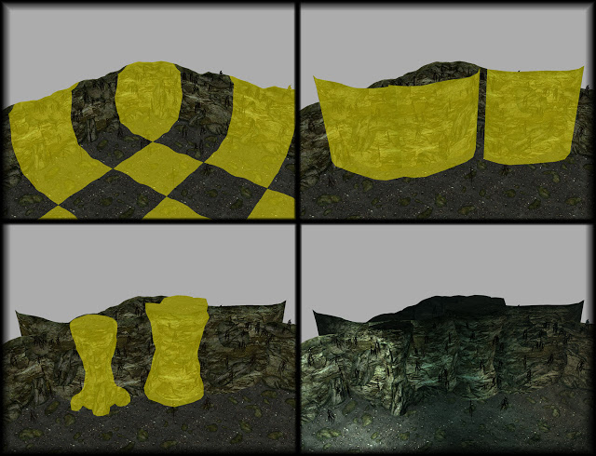
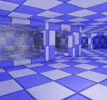
Level Design
What is the ideal Process?
What comes first?
The art or the level?
Whiteboxing
Modular systems and world-building tools
It’s never 100% one way.

Slide 24
What is the game space?
World Context
Gamespaces and GameMechanics
Consistency

Slide 25
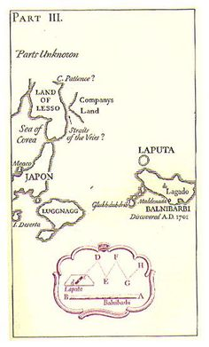
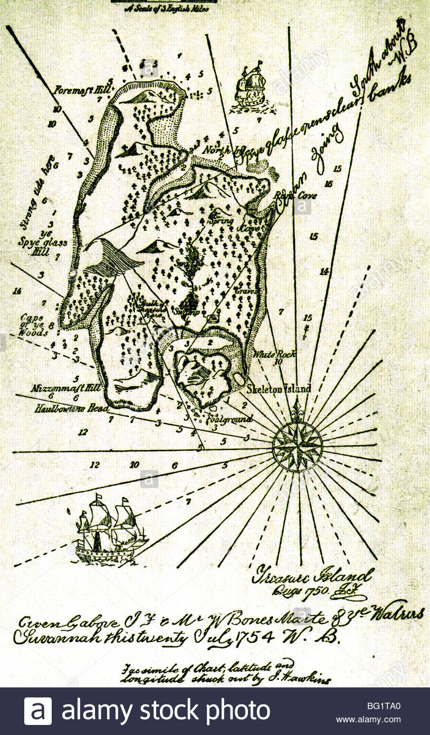
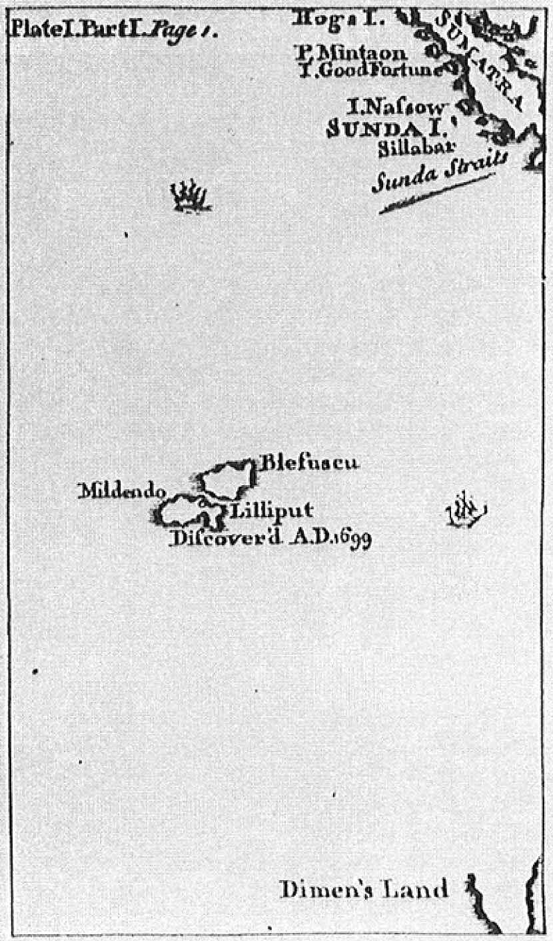
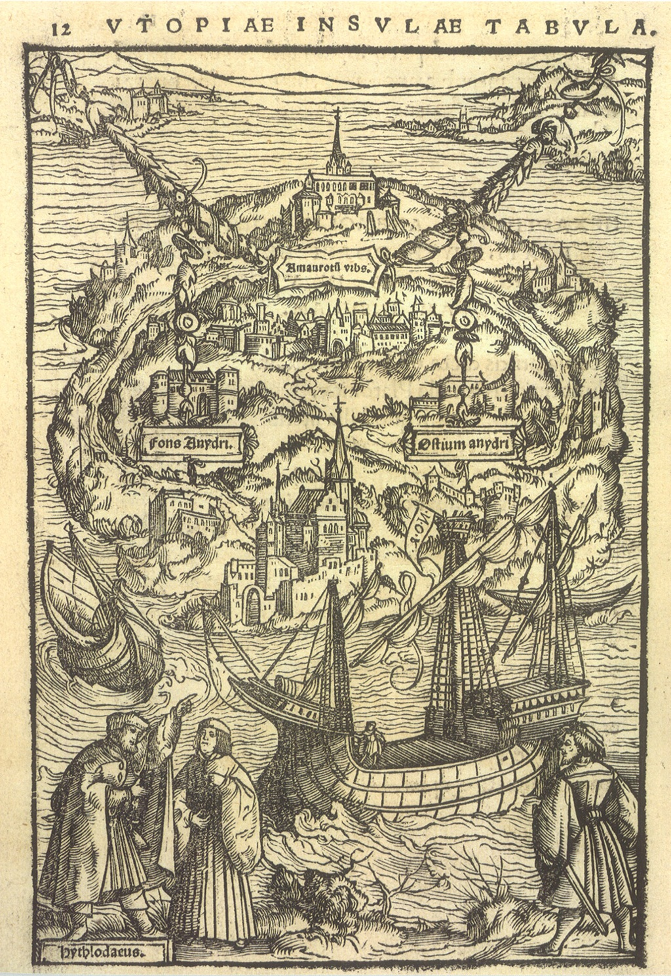
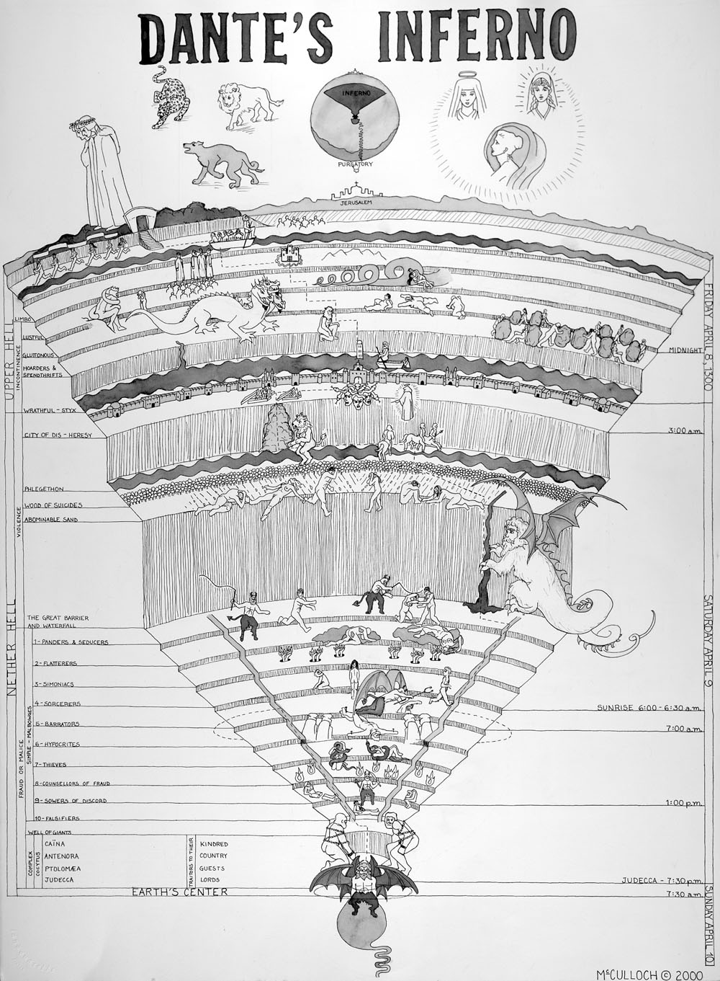
Fictional Cartography
Maps have appeared in works of fiction for a long time. The earliest intentionally fictional maps go back centuries.
In the late 15th century the 'hell' of Dante's inferno was first illustrated,
Thomas More's Utopia (1516) contained a map of the novel's fictional island.
As did Jonathan Swift's Gulliver's Travels (1726)
And Robert Louis Stevenson's Treasure Island (1883) where it has been suggested the map came before the novel (Ekman. 2013).

Slide 26
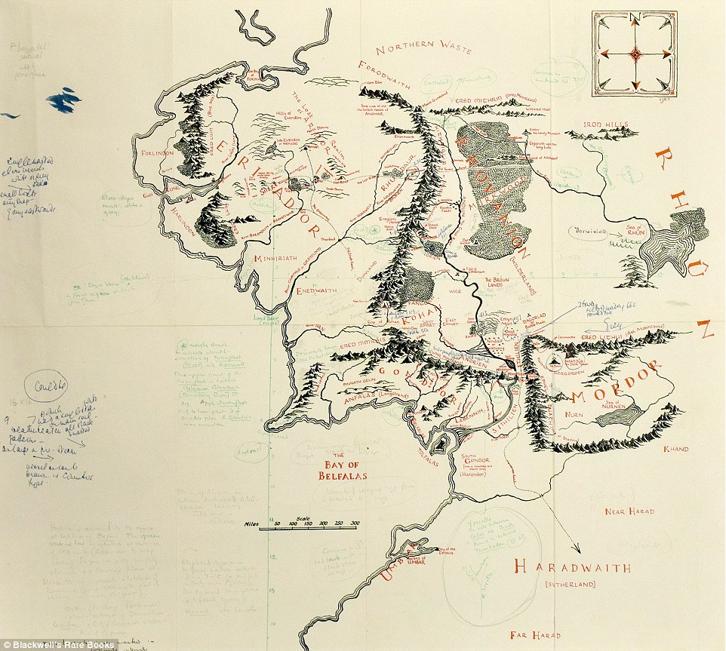
Fictional Cartography
But many consider J R R Tolkien the first major fantasy worldbuilder for his Middle Earth maps and stories.

Slide 27
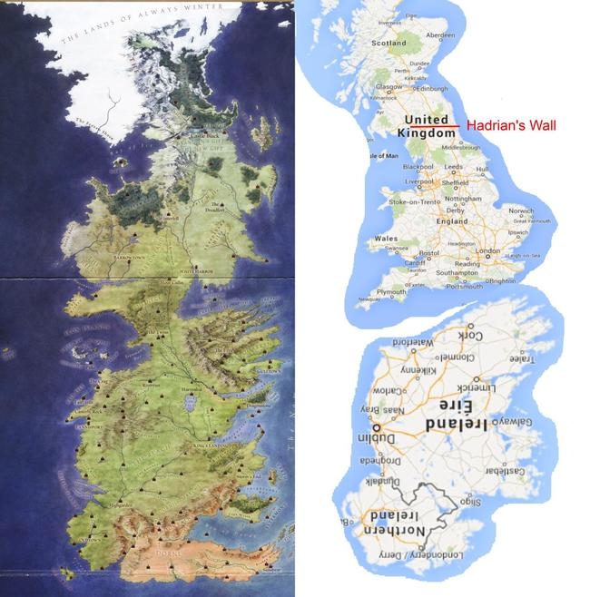
Westeros
A Song of Ice and Fire (Game of Thrones)

Slide 28
Fake Cartography
Tolkien's world building didn't stop at maps and included the invention of entire languages, races and cultures, history, genealogy and even songs.
Tolkien has influenced fantasy and science fiction hugely and similar maps are now almost a requisite in fantasy novels.
Basically his world building provides a superbly detailed (and consistent) context for his stories to exist within.
Alberto Manguel's classic collection of fantasy maps 'The Dictionary of Imaginary Places' (Manguel. 1980) collected hundreds of these fictional maps together. Some taken verbatim from their original source material, some redrawn and tidied up from their original form.

Slide 29
Worldbuilding
How important are these contexts for the success of the stories themselves?
Is it important how far apart they are?
What cultures are created for them?
What the climate in an area is like?
The history of what went before?

Slide 30
Worldbuilding
Some of the best and most detailed world building has been done for table top roleplaying games.

Slide 31
Worldbuilding
A good example of this is the fantasy world known Keithera (known as Hârn) and the game system HârnMaster (Crosby 1980 +).
This fantasy role playing world was created by N Robin Crosby who then worked on it exclusively for almost 30 years until his death in 2008.
The world was based on medieval and pre-medieval earth civilizations and was, despite being a fantasy, low on magic and leaned heavily towards being realistic.

Slide 32
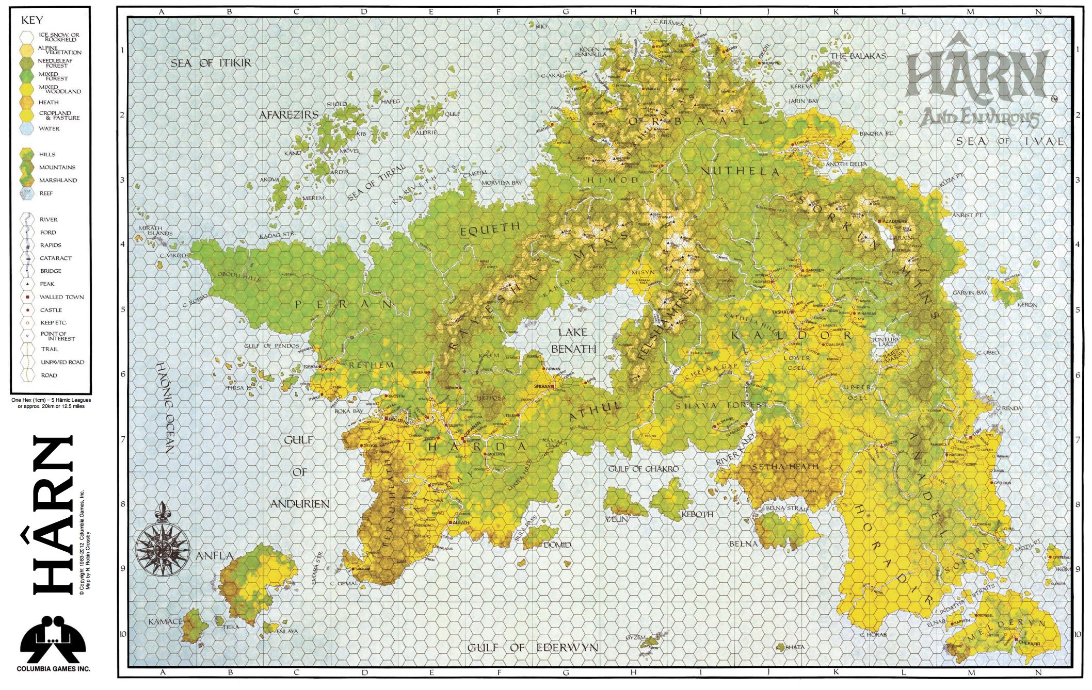

Slide 33
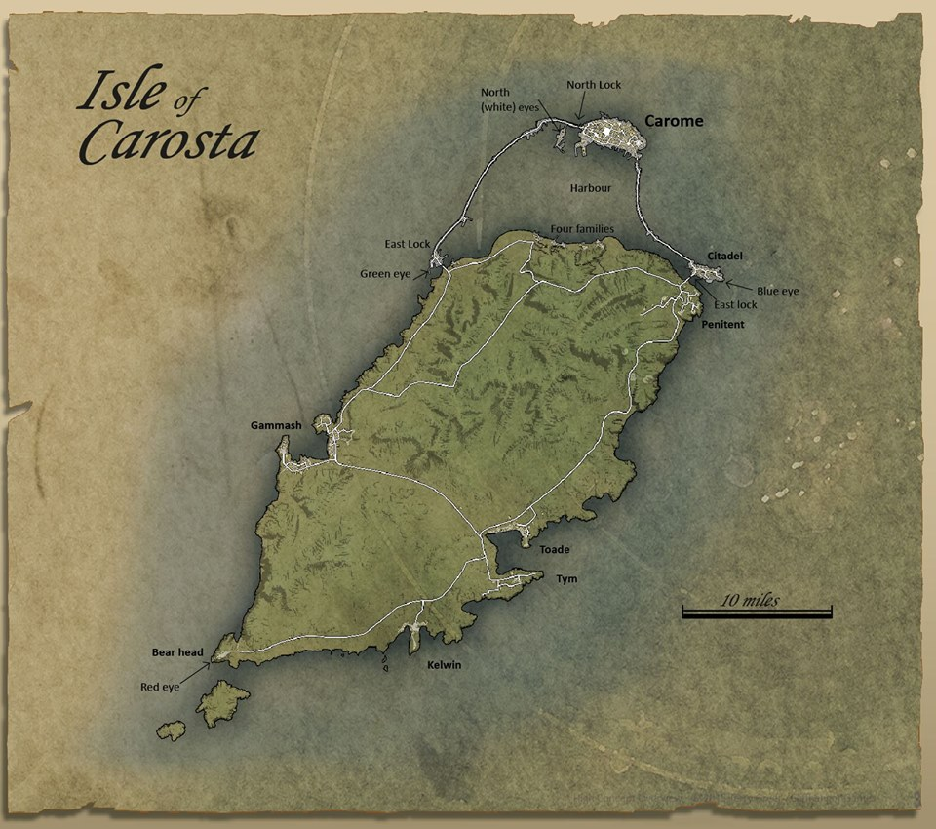

Slide 34
Approaches
Top Down or bottom Up?
Do you start with the smallest elements in your world and build up?
Or start with the world?

Slide 36
WorldBuilding
World building can be a deeply intellectual exercise.
This is often clearly shown in work that attempts to use extrapolated scientific principles for fantasy, science fiction and even magic.
"It has been charged that in restricting ourselves to "scientific accuracy" my colleagues and I are narrowing the scope of usable story ideas available to us. My answer, mathematically rather horrible but defensible under literary standards, is that the square root of infinity is not really that much smaller than infinity as far as resource material goes.”
Hal Clement 'The Creation of Imaginary Beings' (Clement 1991

Slide 37



Slide 38
Logical Extrapolation
This approach doesn't preclude the breaking of reality.
But… does ensure that whenever it's done it is carefully considered.
World building this way may make one or two large inventions, but the resultant world is then extrapolated logically using forces and mechanisms that are well understood or credibly inferred from what has already been decided.

Slide 39

Logical Extrapolation

Slide 40


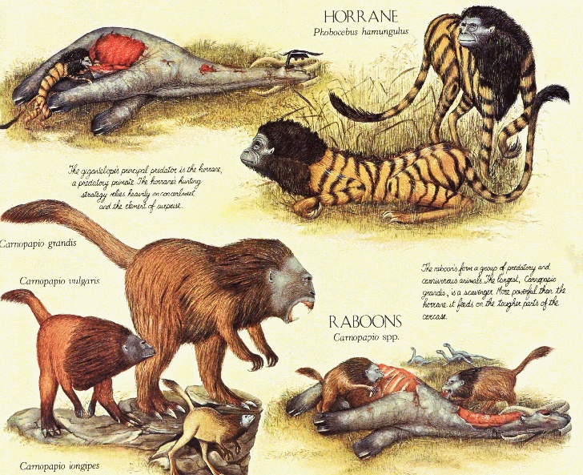

Slide 41
Logical Extrapolation
Some think this approach constrains creativity, but:
There is evidence in research into the technique of brainstorming that shows that a lack of restrictions can actually hamper creativity (Lehrer. n.d.)
And only when brainstorming is tightly focused does it succeed (Keeney. 2012).

Slide 42
Logical Extrapolation
Now apply this to:
Politics
History
Languages
Weather
The climate
Biomes
Religions
Geomorphology
The world’s physical systems
The planetary system
And so on

Slide 43
Remember the Kipling Questions
What?
Why?
When?
How?
Where?
Who?
When fleshing out your Context remember:
I keep six honest serving men (They taught me all I knew); Their names are What and Why and When And How and Where and Who
(Kipling 1902)
Notes:
I Keep Six Honest Serving Men I KEEP six honest serving-men (They taught me all I knew); Their names are What and Why and When And How and Where and Who. I send them over land and sea, I send them east and west; But after they have worked for me, I give them all a rest. I let them rest from nine till five, For I am busy then, As well as breakfast, lunch, and tea, For they are hungry men. But different folk have different views; I know a person small— She keeps ten million serving-men, Who get no rest at all! She sends'em abroad on her own affairs, From the second she opens her eyes— One million Hows, two million Wheres, And seven million Whys!

Slide 44
What is the game space?
World Context
Gamespaces and GameMechanics
Consistency

Slide 45
Gamespace Limits
What are these limits of your worldspace?
What agency do you have with the game world? E.g:
Can you chop down trees?
Do they stay chopped down?
Can you do anything with the wood?
Can you make chopsticks?
Paper?
Where does the simulation end and the emulation begin?

Slide 46
Gamespaces and GameMechanics
Gamespaces are not the real world.
You cannot just do what you want within a game.
You are restricted to a subset of options that the game allows.
Can you think of times when you were prevented from doing simple things in a game that should logically have been easy to do.

Slide 47
How do we know what we can and can’t do?
We quickly learn what is possible and impossible in a game environment.
It’s hard to know how we learnt all the rules for a game genre – but it’s clear we expect a set of rules for each game genre.
We are surprised when we find a game that offers something more.
Or something less.

Slide 48
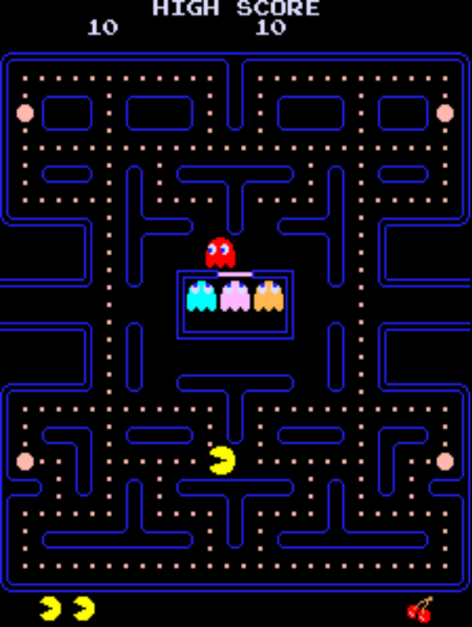
Lets look at an example of how the playspace is used in conjunction with game mechanics.

Slide 49
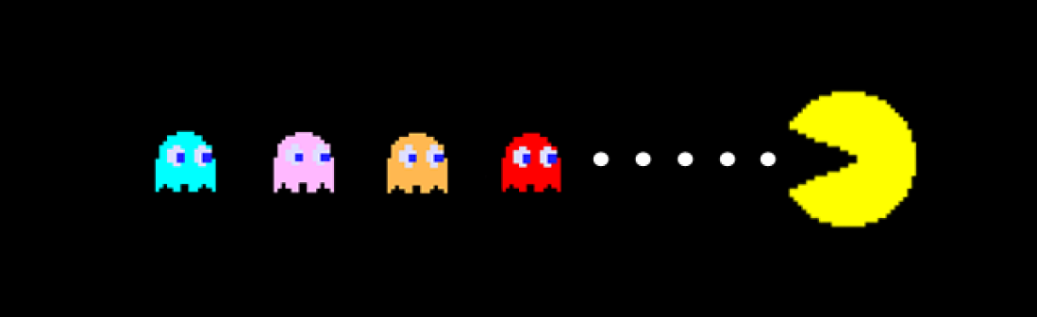
Each Ghost has it’s own set of movements
Do the ghosts move the same way?
Lambie (2017 )http://mentalfloss.com/article/90874/your-pac-man-game-learning-different-strategies-each-ghost

Slide 50
Each Ghost has it’s own set of movements
In chase mode, Blinky’s target is Pac-Man, and the ghost will hunt the player constantly until its pattern switches to scatter mode, when it heads back to its corner of the maze. There is, however a bit of a twist: when there are 20 dots left in the maze (increasing at higher levels), Blinky’s speed will increase slightly. Its speed will increase yet again when there are 10 dots left. At these points, Blinky’s behavior in scatter mode will also change; instead of moving back to its corner at the top right of the maze, it will continue to chase Pac-Man. This behaviour makes Blinky the most fearsome character in the game, since it’ll only switch back to its less speedy, persistent state once the player’s either eaten all the dots or lost a life.
Lambie (2017 )http://mentalfloss.com/article/90874/your-pac-man-game-learning-different-strategies-each-ghost

Slide 51
Each Ghost has it’s own set of movements
Clyde’s (the orange ghost) The wiliest of all the ghosts, Inky’s movements are perhaps the most difficult to track. This is because its target is based not just on the player’s direction and position, but also Blinky’s. In chase mode, Inky heads to a space just in front of Pac-Man (much like Pinky), but just to make things more confusing, it will then move that position to a spot that is twice the distance from Blinky’s current position.
In other words, Inky draws a line from Blinky, through a spot two spaces in front of Pac-Man, and will head to a position that is double the distance from Blinky. This gives the impression of almost random movement when Inky’s further away, but will mean that, as Blinky closes in on Pac-Man, Inky will start to get closer, too. Inky is, however, weighed down with the same bug as Pinky, and can also be fooled into moving in the wrong direction in a similar fashion.
Lambie (2017 )http://mentalfloss.com/article/90874/your-pac-man-game-learning-different-strategies-each-ghost

Slide 52
Each Ghost has it’s own set of movements
Pinky's strategy for taking down Pac-Man is a bit more strategic. It's programmed to take a route to a position four spaces ahead of wherever Pac-Man’s moving, which can easily leave the player trapped. But there is a bug that can work in your favor: when Pac-Man’s moving up the screen, Pinky will target a space four squares in front of his position and four squares to the left. Skillful players can exploit this to their own advantage, and confuse Pinky’s AI by briefly moving towards the ghost as it closes in—this will often send it down a different branch of the maze as its target in front of Pac-Man suddenly shifts.
Lambie (2017 )http://mentalfloss.com/article/90874/your-pac-man-game-learning-different-strategies-each-ghost

Slide 53
Each Ghost has it’s own set of movements
Inky’s movements are perhaps the most difficult to track. This is because its target is based not just on the player’s direction and position, but also Blinky’s. In chase mode, Inky heads to a space just in front of Pac-Man (much like Pinky), but just to make things more confusing, it will then move that position to a spot that is twice the distance from Blinky’s current position.
In other words, Inky draws a line from Blinky, through a spot two spaces in front of Pac-Man, and will head to a position that is double the distance from Blinky. This gives the impression of almost random movement when Inky’s further away, but will mean that, as Blinky closes in on Pac-Man, Inky will start to get closer, too. Inky is, however, weighed down with the same bug as Pinky, and can also be fooled into moving in the wrong direction in a similar fashion.
Lambie (2017 )http://mentalfloss.com/article/90874/your-pac-man-game-learning-different-strategies-each-ghost

Slide 54
Integrating Gamespaces with gameplay mechanics
A game’s mechanics are entirely contained within the gamespace.
They are therefore part of the gamespace.
Examples:
Jumping distance/height
Line of sight and speed
Health and damage
Slope restrictions.
? What else ?

Slide 55
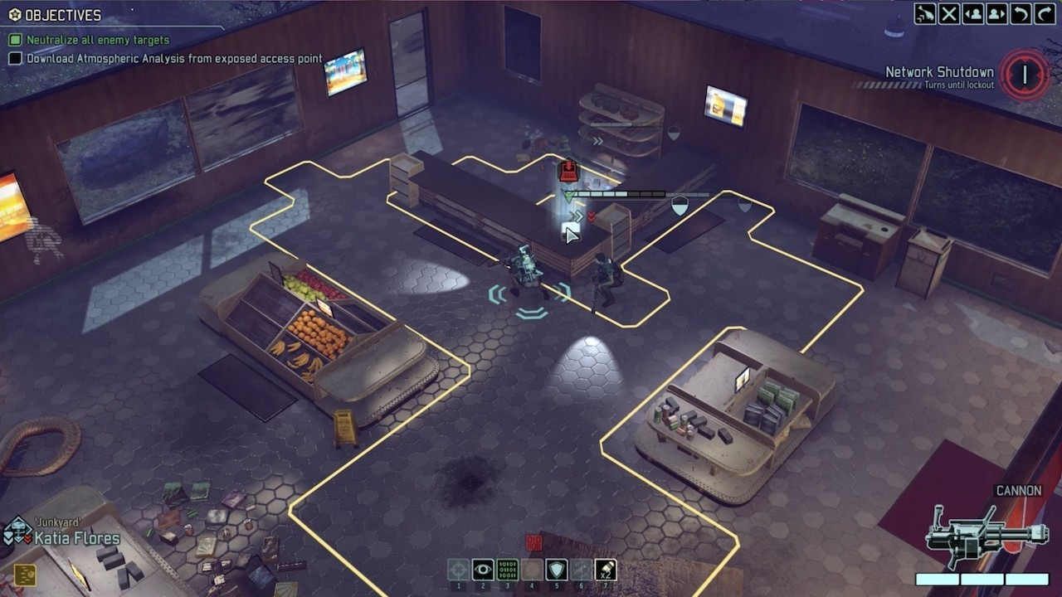
Integrating Gamespaces with gameplay mechanics
Rules are inextricably tied to the gamespace.
If dice (or movement points) are used for movement – the gamespace requires some form of Grid or ladder.

Slide 56

Integrating Gamespaces with gameplay mechanics
Rules are inextricably tied to the gamespace.
A jump implies gravity.
A jump also implies a way of bypassing blockages or gamespace navigation.
It also requires that the gamespace makes use of that mechanic
Otherwise, why have a jump in the first place?

Slide 57
Integrating Gamespaces with gameplay mechanics
This means gamespaces and mechanics should exhibit …
SYNERGY
Def:
The interaction or cooperation of two or more organizations, substances, or other agents to produce a combined effect greater than the sum of their separate effects.

Slide 58
Integrating Gamespaces with gameplay mechanics
Given you have mechanics (such as a jump).
When dealing with parts of a gamespace (ie a level) :
Do you design the level to the mechanics
Customise the mechanics to the level?
Which is preferable?
Why?

Slide 59
What is the game space?
World Context
Gamespaces and GameMechanics
Consistency

Slide 60
Consistancy
How important is consistency within a playspace?
What happen if you are inconstant?
How do you obtain constancy within the game world?

Slide 61
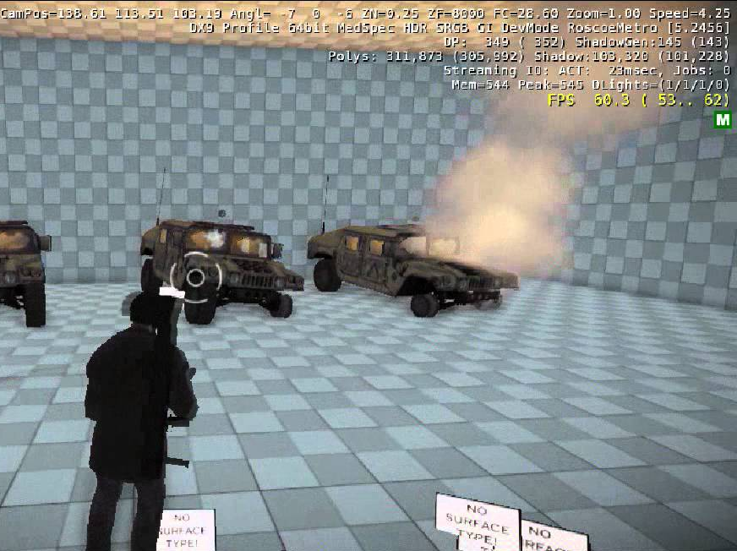
Testbeds
Normally a level is set up where the main core mechanics can be tested.
There’s no standard name for this:
Testbed
Test level
Blockout room
Whiteroom
Whitebox room
Sandbox
It is however important to ensure constancy by avoiding extraneous level elements.

Slide 62
Gravity
Imagine you are developing a platformer.
Should gravity always be constant? If not under what could change it?
Should a player’s jump height and distance always be consistent? If not under what criteria can you change it?
Should a players action always be predictable? If not under what conditions can this be changed?

Slide 63
Consistancy
Players should not be ‘unnecessarily’ confused.
Believability is more important than realism.
If you want something to vary through a game:
Have a reason for it (built into the context or gamespace)
Do it if it makes the player feel awesome – and it won’t be noticed (but are you really sure it won’t be).

Slide 64
Consistancy
Only break rules and consistency when you know what you’re doing and why.
Never do it by accident or on a whim

Slide 65
Recap
The game space encompasses The game, levels and game mechanics (and normally the context).
Gamespace bounds the gam
Gamespaces can be considered heirachical
Levels are a sub-gamespace – sometimes with modified mechanics.
The World Context is integral to the gamespace.
The gamespace and mechanics should exhibit synergy.
Be consistent – unless you have a VERY good reason to not be.

Slide 66
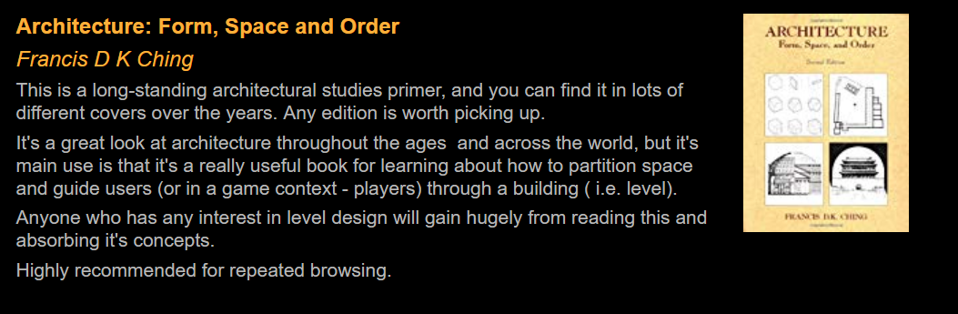
Recommended
Ching, F.D.K., 2007. Architecture--form, space, &amp; order 3rd ed., John Wiley & Sons.

Slide 67
References
Ching, F.D.K., 2007. Architecture--form, space, &amp; order 3rd ed., John Wiley & Sons.
Clemant, H., 1991. The Creation of Imaginary Beings. In Writing Science Fiction and Fantasy. St. Martin’s press.
Crosby, N.R., HârnWorld Maps | Kelestia.com. 1980 onwards. Available at: http://www.kelestia.com/catalog/58 [Accessed December 28, 2015].
Dixon, D., 1981. After Man, Granada Publishing; New edition edition (4 Nov. 1982).
Evans, S.J., 2015. Map of Middle-Earth with Tolkien’s hand-written notes gives insight into his mind | Daily Mail Online. Mail Online. Available at: http://www.dailymail.co.uk/news/article-3287440/Show-way-Mordor-Unique-hand-drawn-map-Middle-Earth-gives-rare-insight-Tolkien-s-mind.html [Accessed January 6, 2016].
Manguel, A., 1980. The Dictionary of Imaginary Places: The Newly Updated and Expanded Classic: Amazon.co.uk: A Manguel: 9780613563116: Books, Turtleback books. Available at: http://www.amazon.co.uk/The-Dictionary-Imaginary-Places-Expanded/dp/0613563115 [Accessed December 24, 2015].
Ryan Lambie, 2017. Up Your “Pac-Man” Game by Learning the Different Strategies of Each Ghost | Mental Floss. Mental Floss. Available at: http://mentalfloss.com/article/90874/your-pac-man-game-learning-different-strategies-each-ghost [Accessed February 7, 2018].
Schell, J. (2008). The Art of Game Design: a Book of Lenses. Ch. 10. USA: Morgan Kaufmann.

